Slide 1
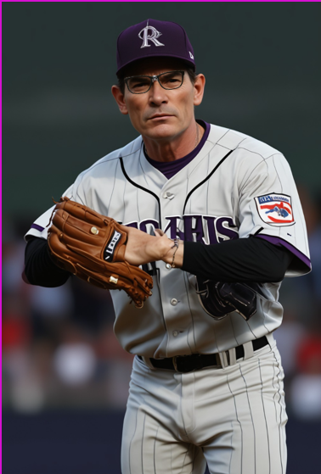


Moneyball Part III - The Trilogy
PitchPerfect App - Delivering the Pitch They Won’t See Coming.
10/30/2024

Slide 2




Team
Liz Cooney
Howard Dixon
Cassy Miller
Sandokan Stage

Slide 3
1
2
3
4
5
6
Introduction:
Team
Executive Summary
Data Overview + Approach
Model:
Neural Network
App1
LLM Chatbot
App2
Conversational UI
Wrap-up
Long term approach
Results:
Conclusion
Questions
AGENDA

Slide 4
Executive Summary
Data Overview and Approach
The Colorado Rockies are set to transform their pitching strategy through the development of an advanced, machine learning-powered app. This innovative solution leverages transformer models and neural networks to provide dynamic, data-driven recommendations for every pitch. By integrating both real-time and batch-processed information—such as batter tendencies, each pitcher's strengths, weather conditions, and game context—the app offers strategic insights that adapt to every situation, empowering coaches and players to make the best possible decisions on the field.
The app utilizes a combination of chatbot interfaces and file-based data uploads to make complex data easily accessible and actionable. Coaches and players can quickly obtain critical recommendations through the chatbot, while file uploads allow for processing larger datasets that yield deeper insights. Additionally, the app provides visual data representations that simplify the understanding of pitching strategies and performance metrics, allowing users to quickly assess and adjust their game plans.
Through seamless collaboration with coaches, analysts, and players, the app has been designed to be both user-friendly and highly effective, ensuring its adoption into daily routines and game strategy. The chatbot interface facilitates instant access to insights, enabling on-the-fly adjustments during games while maintaining a focus on ease of use. The ultimate goal is to enhance the Rockies' competitive edge by optimizing pitching performance, improving key metrics such as strikeout rates, reducing walk rates, and enhancing overall ERA.
The development of this app involves cutting-edge machine learning algorithms capable of analyzing vast datasets, including historical performance, current trends, and situational variables. By leveraging transformer models, the system can quickly process complex patterns and identify the optimal pitch for every scenario, providing a deeper understanding of the game dynamics. The scalability of the app also ensures seamless integration with existing analytics tools, making it an adaptable addition to the Rockies' workflow. The integration of cloud computing resources further enhances the app’s performance, ensuring data processing is fast and efficient even under heavy loads. This powerful technology empowers the Rockies to be proactive, rather than reactive, in their strategic approach.
This project also has broader potential, with plans to scale its functionality for batting strategies, provide enhanced real-time chatbot capabilities, and extend its application beyond the Rockies to other teams across Major League Baseball. By taking the "Moneyball" concept to a new level with state-of-the-art machine learning techniques, the Rockies are positioned to lead Major League Baseball into the future of data-driven sports analytics, setting a benchmark for how teams can leverage technology to achieve strategic excellence.
Notes:
The Rockies are using a machine learning app for real-time pitching recommendations, leveraging neural networks that consider batter tendencies, pitcher strengths, weather, and game context to optimize performance.
The app features a user-friendly interface with a chatbot for quick insights, data uploads for deeper analysis, and visual representations to simplify understanding.
This technology provides a competitive edge by enabling real-time decisions that improve key metrics such as strikeouts, walks, and ERA. Advanced transformer models and cloud integration ensure fast processing, while future plans include expanding to batting strategies, other teams, and advancing the "Moneyball" concept with cutting-edge machine learning.

Slide 5
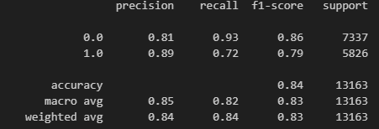

App Development
Data Collection
Neural Network Model
User Interface Integration
Goal: Develop an app that would allow coaches to ask a chatbot a question regarding what pitch should be thrown to get a strike.
Process: Gather pitching data for the Colorado Rockies Starting Pitchers. Our data contains pitching data for every pitch Kyle Freeland, German Marquez, Antonio Senzatela, Ryan Feltner, and Chris Flexen have ever thrown.
Key data:
- Pitch count, batter, handiness, inning, balls/strikes at time of pitch, trailing pitch, runners on bases.
Model: Neural Network.
Cleaning data – removing data that a coach would not have at time of pitch call.
One Hot Encoding
Embedding layer for batter / other features.
Two hidden layers.
Predicting outcome being strike or other.

Slide 6
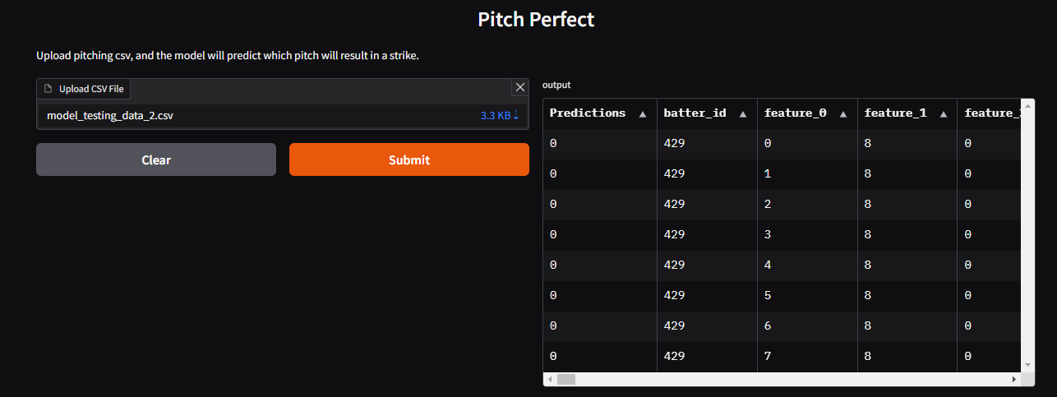
App Deployment
Data Collection
Neural Network Model
User Interface Integration
Model Deployment:
Saving the model for use in future predictions, such as the chatbot app.
Gradio App:
Data limitations: inputs for the model too large for simple chat inputs.
Restructured to take a file upload, and return a dataframe with predictions on whether pitch thrown would result in a strike.

Slide 7
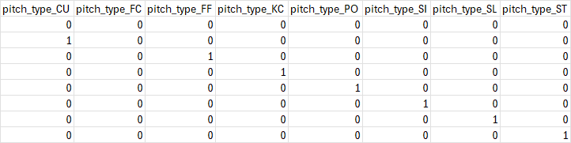
App Use
Data Collection
Neural Network Model
User Interface Integration
Preprocessed file formatted to match the training and testing data.
Scenario we're using the model to help us predict:
Rockies are playing the Yankees in the home opener, and Gleyber Torres is up to bat. First pitch of the day, German Marquez on the mound, what should we throw?
Keeping all other data points consistent, and changing the boolean for pitch type, the model predicts the Rockies will not throw a strike on the first pitch.

Slide 8
User Interface
Data Collection
Neural Network Model
User Interface Integration
Key Points:
Developed 3 companion apps to the neural network, with easy user input and clear AI output.
1: Neural Network Simulator
2: General Baseball Chatbot
3: Speech to Text Baseball Chatbot

Slide 9
Conversation Mgmt/ Speech Recognition
Data Collection
Neural Network Model
User Interface Integration
General Chatbot - Key Points:
Streamlit UI
Pulls PDFs from local directory and online Wikipedia articles via WikipediaLoader
Stores data with OpenAIEmbeddings and vector_store
Custom prompt template to direct the LLM to only respond to Baseball questions
Utilizes ConversationalRetrievalTrain for maintaining context.
AI responds based on previous interactions.
Speech-to-Text Chatbot - Key Points:
Gradio UI
Uses Google Web Speech for audio transcription.
Loads data from Wikipedia articles using WikipediaLoader
Handles errors and provides feedback for unrecognized speech.

Slide 10
Current State
Currently, we are leveraging a Gradio app to handle our model interactions, given the limitations we faced with using simple chat inputs. Initially, the data requirements for our model involved numerous variables and complex details that made simple chat inputs inefficient. The input size was too extensive, requiring a more robust solution to handle the data effectively.
To address this, we restructured our approach by enabling file uploads, allowing us to work with larger datasets efficiently. The Gradio app now supports uploads in standard formats, such as CSV or Excel files, enabling easy data entry and integration.
With this setup, users can upload a file containing the relevant data, and the app processes it to return a dataframe that includes predictions on whether a pitch thrown would result in a strike. For example, coaches can upload historical game data, and the app will provide a detailed analysis that helps determine the best pitch for different scenarios. This approach not only helps in handling larger input sizes but also allows for a more detailed analysis of the data, providing coaches and players with a deeper understanding of pitch outcomes based on specific game conditions.
Key Advantages of the Current Approach:
Scalable Data Handling: File uploads allow for the efficient processing of larger datasets that are too complex for simple text input.
Improved Accuracy: By analyzing a comprehensive dataset, the model can generate more accurate predictions, enhancing decision-making.
Enhanced User Experience: The ability to upload data files simplifies the process for coaches and players, ensuring ease of use without sacrificing analytical depth.
Detailed Insights: The returned dataframe offers a granular view of pitch outcomes, helping coaches and players refine their strategies based on precise game conditions.
Notes:
Purpose of the Feature Importance Chart:
The chart helps us understand which features (or data points) are most important or influential in the Linear SVM model when predicting the outcome of a game (like whether a team wins or loses).
How Feature Importance is Determined:
In a Linear SVM, the model assigns a weight (or coefficient) to each feature. These weights represent how strongly each feature influences the final prediction.
The larger the weight (in absolute value), the more important the feature is in helping the model make its decision.
What the Chart Shows:
The x-axis shows the importance value (weight) of each feature.
The y-axis lists the different features used in the model (e.g., Opponent’s At-Bats, Colorado Rockies Home Runs)

Slide 11
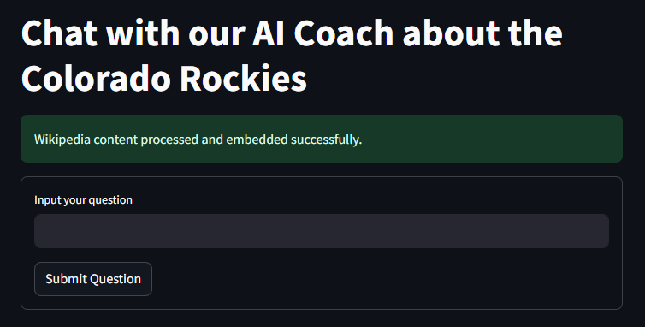
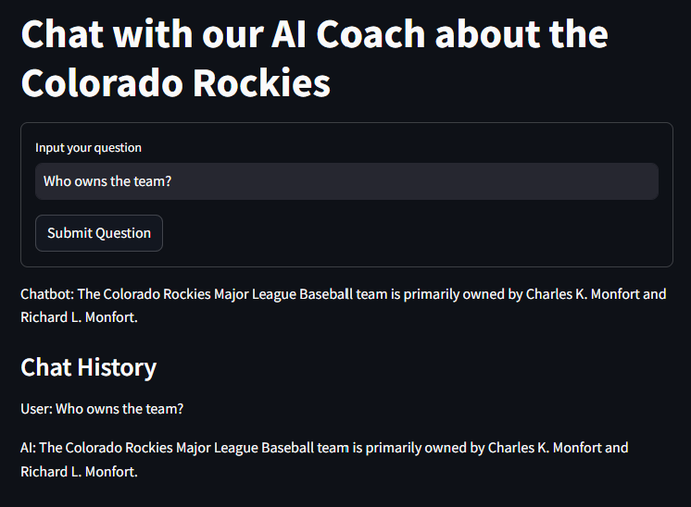
Companion App 1 – General Chatbot

Slide 12
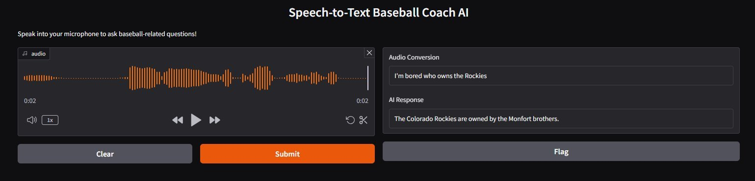
Companion App 2 – Audio Chatbot
Public Link:
Speech-to-Text Baseball Coach AI

Slide 13

Future State
Looking ahead, our next build will focus on introducing an advanced chatbot feature that will revolutionize in-game decision-making for the Colorado Rockies. This enhancement will allow coaches and players to interact seamlessly with the app by describing game conditions—such as outs, base runners, and batter profiles—to receive instant, data-driven recommendations for the optimal pitch. The conversational interface will simplify the complexity of analytics, providing actionable insights in real time and ultimately enhancing strategic precision on the field.
NN Model Updates:
Simplifying Inputs: Less columns of data (not one hot encoding home and team would clear up a lot of columns for input)
Expanding Model Scope: Adding more batter statistics that may make the model stronger.
Key Features of the Chatbot Enhancement:
Real-Time Interaction: Coaches and players can provide game scenarios and receive instant, actionable recommendations.
Conversational Interface: Uses natural language, making complex data intuitive and easy to understand.
Tailored Insights: Delivers recommendations customized to the specific game situation, boosting the decision-making process.
Seamless Integration: Designed for quick and easy use during games, allowing coaches and players to leverage data without interruption.
Enhanced Strategic Adaptability: Ensures adaptability by providing insights that evolve with changing game dynamics.
AI-Driven Learning: Recommendations improve over time as the chatbot learns from past games, ensuring smarter decisions with each use.
Collaboration with Coaches: Developed with direct feedback from coaches and players to align with real-world needs effectively.
Game Context Awareness: Considers external factors such as weather and pitcher fatigue to provide more holistic recommendations.
Notes:
Purpose of the Feature Importance Chart:
The chart helps us understand which features (or data points) are most important or influential in the Linear SVM model when predicting the outcome of a game (like whether a team wins or loses).
How Feature Importance is Determined:
In a Linear SVM, the model assigns a weight (or coefficient) to each feature. These weights represent how strongly each feature influences the final prediction.
The larger the weight (in absolute value), the more important the feature is in helping the model make its decision.
What the Chart Shows:
The x-axis shows the importance value (weight) of each feature.
The y-axis lists the different features used in the model (e.g., Opponent’s At-Bats, Colorado Rockies Home Runs)

Slide 14

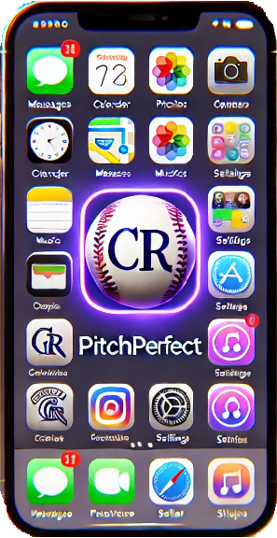
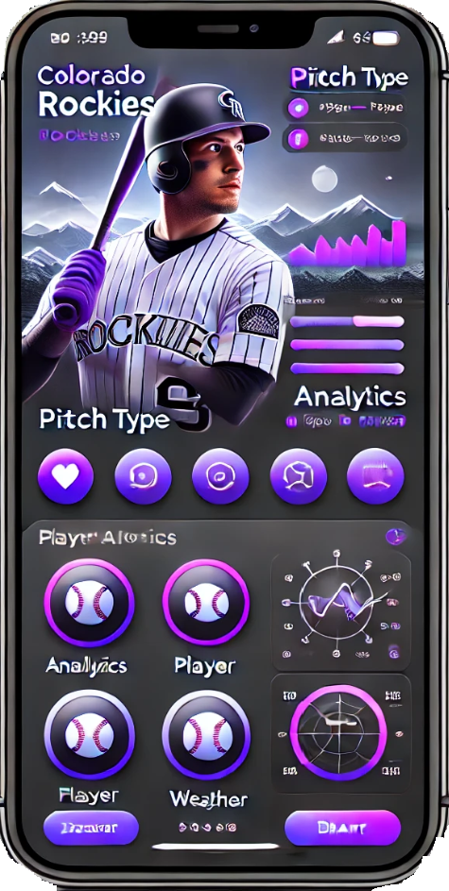
Prototype - Mobile APP
The Colorado Rockies Mobile Pitching App puts advanced analytics directly into the hands of pitchers and coaches. Designed to provide real-time, data-driven recommendations during games, the mobile app ensures that critical insights are easily accessible, even from the dugout. By leveraging machine learning models, the app analyzes batter tendencies, pitcher strengths, and game context to make pitch recommendations that maximize success.
Benefits:
Real-Time Insights: Get immediate pitch suggestions tailored to the current batter and game situation.
Ease of Use: The user-friendly interface ensures that coaches and players can quickly and effectively leverage data without interrupting game flow.
Portable: Available right at your fingertips, the mobile app is optimized for use in the dugout or on the field, making analytics available wherever they are needed.
Key Takeaways:
The mobile app empowers coaches and pitchers with real-time data to enhance decision-making.
Easy accessibility and simple design make it ideal for on-the-go use.
The app provides an edge by helping pitchers make the best choices, increasing competitive advantage.
Notes:
The Rockies' Mobile Pitching App brings advanced analytics directly to pitchers and coaches, providing real-time recommendations to enhance decision-making during games. By analyzing batter tendencies, pitcher strengths, and game context, the app delivers optimized pitch suggestions accessible anytime, even from the dugout.
Benefits:
Real-Time Insights: Immediate pitch suggestions based on game situation.
Ease of Use: User-friendly interface for quick access to data.
Portability: Optimized for use in the dugout or on the field, ensuring insights are always at hand.
Key Takeaways:
Empowers coaches and pitchers with real-time data.
Simple design ideal for on-the-go use.
Helps make informed choices, boosting competitive advantage.

Slide 15

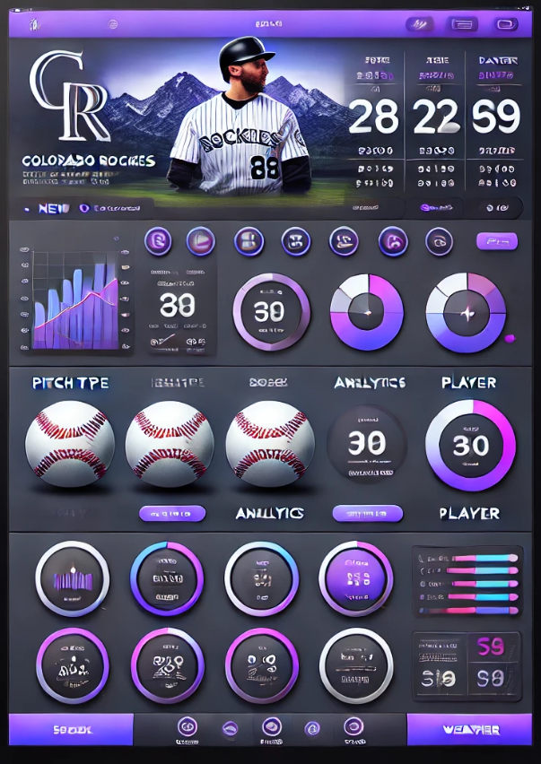
Prototype - iPad | Tablet
The Colorado Rockies iPad and Notebook Pitching App provides a more comprehensive analysis experience for pitching strategy. Designed for pre-game preparation and in-depth mid-game analysis, this version of the app allows coaches to visualize data trends, explore scenarios, and develop winning strategies that align with each pitcher's strengths. The larger screen and more detailed views make this the ultimate coaching tool for enhancing the Rockies' pitching approach.
Benefits:
Comprehensive Analysis: Delivers a more in-depth analysis of pitcher performance, batter history, and game dynamics.
Enhanced Visualization: Larger screen allows for better visualization of complex data, heat maps, and comparative analyses.
Strategic Preparation: Ideal for pre-game planning and in-game adjustments, helping coaches create winning strategies tailored to every scenario.
Key Takeaways:
The iPad and Notebook app offers detailed analysis for strategic decision-making.
Coaches can use visual tools to identify trends, make adjustments, and strengthen pitching plans.
Best suited for both in-depth pre-game preparation and detailed mid-game analysis to outmatch competitors.
Notes:
The Rockies' iPad and Notebook Pitching App provides an in-depth analysis experience for pitching strategy, enhancing pre-game preparation and in-game adjustments. By leveraging a larger screen for enhanced visualization, coaches can explore data trends, analyze scenarios, and create strategies that align with each pitcher's strengths, ultimately optimizing performance.
Benefits:
Comprehensive Analysis: Detailed insights into pitcher performance, batter history, and game dynamics.
Enhanced Visualization: Larger screen enables better understanding of complex data, heat maps, and comparisons.
Strategic Preparation: Ideal for both pre-game planning and in-game adjustments to optimize strategies.
Key Takeaways:
Supports strategic decision-making with detailed analysis.
Visual tools help coaches identify trends and strengthen pitching plans.
Suitable for comprehensive pre-game and in-game analysis.

Slide 16
Wrap Up: Conclusion
As we wrap up, it's important to recognize the transformational impact this app will have on the Colorado Rockies' pitching strategy. By integrating advanced analytics, machine learning, and real-time recommendations, we are pushing the boundaries of what is possible in baseball. The Mobile and iPad/Notebook versions of the app each serve unique roles in enhancing game-time decision-making and pre-game preparation, respectively, providing a holistic approach to optimizing pitching performance.
This solution is more than just a tool; it represents a strategic evolution. The real-time adaptability of the mobile app, coupled with the in-depth analysis capabilities of the iPad/Notebook version, ensures that both players and coaches have everything they need to succeed—from the dugout to the locker room. Additionally, the emphasis on user-centric design, seamless integration with existing systems, and adaptability make this a key asset for the Rockies not only for current use but also for future scalability. The app's capability to track player fatigue, provide visual data representations, and deliver insights into player health management is a crucial element that supports both performance and longevity.
Through close collaboration with the coaching staff, players, and analysts, the development process has ensured that the app’s features are aligned with the real-world needs of a professional baseball team. Every recommendation, every insight, and every visualized trend is relevant, actionable, and designed to make a difference on the field. The integration of cloud computing resources guarantees that data processing is fast and efficient, even under heavy loads, allowing for seamless use during games. By combining the power of neural networks, transformer models, and an intuitive user experience, the Colorado Rockies are not just using technology—they are redefining how technology shapes the game, making smarter decisions and staying one step ahead of the competition.
The scalability of this solution means that it is adaptable for future enhancements, such as expanding to batting strategies and integrating new data sources like sensor-based player metrics. This adaptability ensures the Rockies can continue to benefit from emerging technologies, providing them with a dynamic and future-proof strategy to maintain a competitive edge.
Key takeaways:
Holistic Support: Real-time and pre-game insights for better pitching strategies.
Player Health Management: Tracks fatigue and provides insights into physical factors to enhance longevity and well-being.
User-Centric and Integrated: Designed for easy adoption with existing systems, offering a seamless user experience.
Data-Driven Strategy: Uses cutting-edge machine learning to maintain a competitive edge.
Future Scalability: Adaptable to new functionalities, such as batting strategies and sensor-based metrics, ensuring the solution evolves with emerging technologies.

Slide 17
Thank you!
Q&A

Slide 18
Sources
PyBaseball
Gradio
Langchain
Gemini
Tensorflow, sklearn, etc.
Razzball for MBLAMIDs (https://razzball.com/mlbamids/)
Wikipedia
Sportsarchive.net
ChatGPT for assistance with general debugging, building functions, and UI building.

Slide 19
Appendix

Slide 20
Objective
Our project aims to revolutionize pitching strategy for the Colorado Rockies through the development of an advanced, analytics-driven app. Leveraging machine learning with a focus on transformer models, the app will integrate both real-time and batch-processed data, including batter tendencies, game context, and each pitcher's unique strengths, to provide dynamic, situation-specific recommendations. By analyzing vast amounts of data, such as historical performance, game conditions, and pitcher tendencies, this app empowers the Rockies to make informed decisions on the ideal pitch for every scenario, enhancing both strategic planning and in-game adaptability.
The innovative approach employs a combination of neural networks, file-based data uploads, and chatbot interfaces, making data-driven insights readily accessible for coaches and players alike. The file upload feature enables the processing of larger datasets, while the chatbot provides a user-friendly way to interact with the app, ensuring that critical information is available in an easy-to-understand manner. Collaboration with coaches, analysts, and players throughout the development process ensures that the app meets on-the-ground needs, providing relevant, actionable insights that can be seamlessly integrated into game strategy.
The integration of transformer models allows for rapid, precise analysis, offering recommendations that are both adaptive and intelligent. The app's scalability also extends to seamless integration with existing analytics systems, ensuring it can be easily incorporated into the team's current workflow. Additionally, future plans include expanding the app's functionality to support batting strategies, provide enhanced real-time chatbot capabilities, and potentially adapt for use by other teams across the league. This technology aims to elevate the Rockies' pitching strategy by providing an agile, informed edge, taking the "Moneyball" concept to new heights with cutting-edge machine learning insights.

